Slide 1
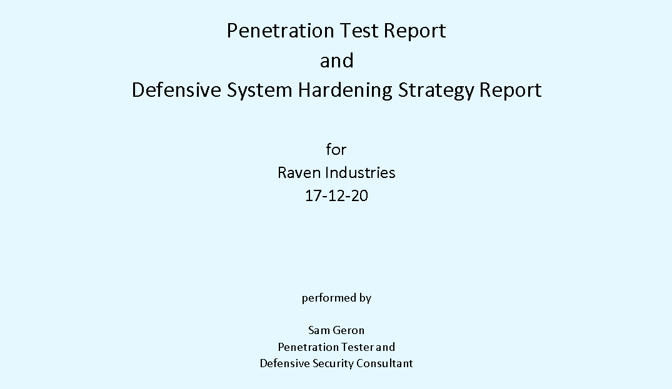

Slide 2

The Brief

Slide 3
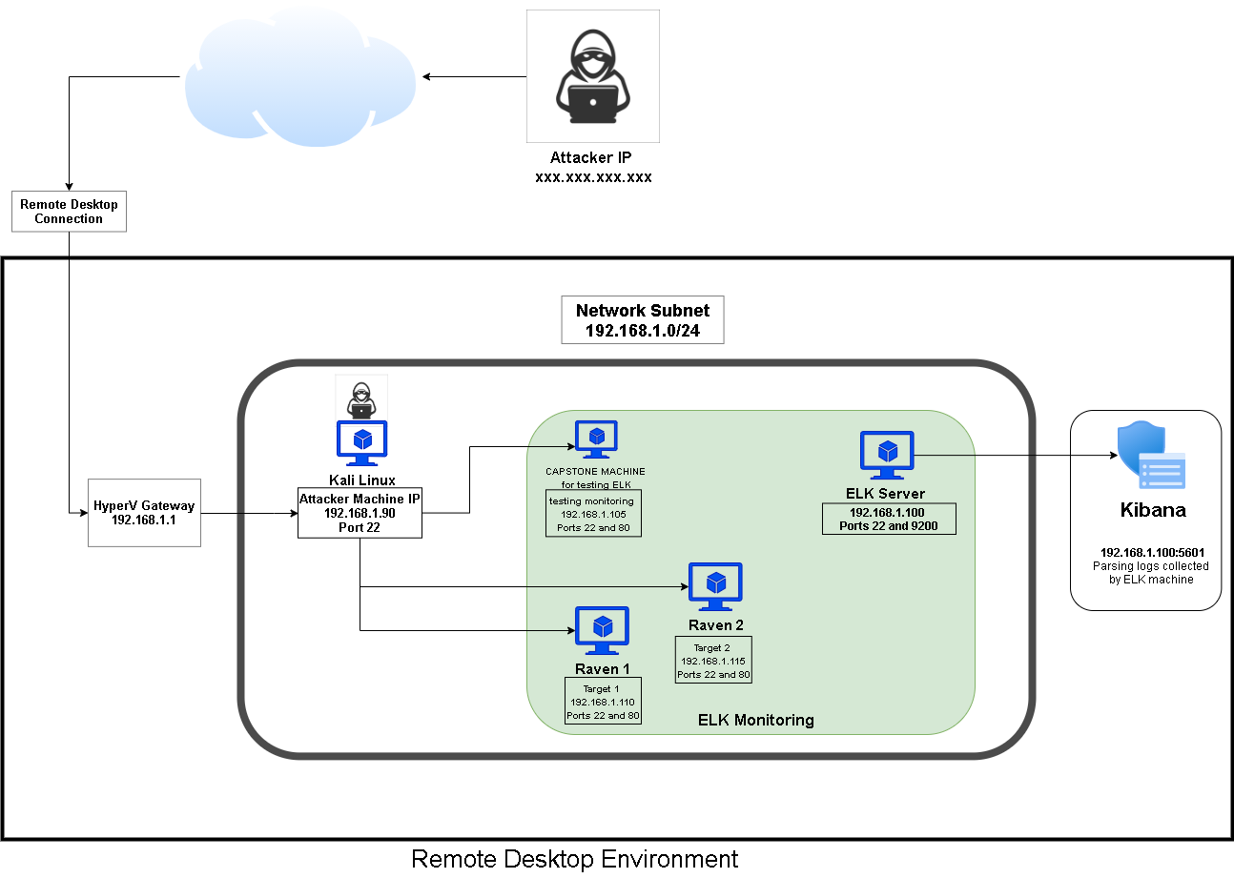
Raven Industries Network Topology
Network
Address Range: 192.168.1.0/24
Netmask: 255.255.255.0
Gateway: 192.168.1.1
Machines
IPv4: 192.168.1.1
Hostname: Gateway
OS: Windows 10 Pro
IPv4: 192.168.1.105
Hostname: Capstone
OS: Linux
IPv4: 192.168.1.90
Hostname: Kali Linux
OS: Linux
IPv4: 192.168.1.100
Hostname: ELK Server
OS: Linux
IPv4: 192.168.1.110
OS: Linux
Hostname: Raven 1
IPv4: 192.168.1.115
OS: Linux
Hostname: Raven 2

Slide 4
Executive Summary of engagement

Slide 5


Vulnerabilities Exploited
5

Slide 6
Critical Vulnerabilities Exploited: Raven 1
The following vulnerabilities were used in compromising Raven 1. Contained within the attached report is a list of 35 vulnerabilities culled from over 100 to be addressed, almost of which will be mitigated by updating applications.
Vulnerability | Description | Impact
Webserver directory listing | Webserver directories are viewable from a browser | Attackers can access internal files at a browser
WPScan brute forcing usernames | Michael and Steven usernames easily brute forced | With usernames, brute force attacks can be launched against SSH login
SSH | Michael’s SSH password could be brute forced and both users could be logged in through SSH | Having access to an SSH login means a system breach. This is tied into password strength.

Slide 7
Critical Vulnerabilities: Raven 1
Vulnerability | Description | Impact
Weak passwords | Michael’s password: - username is password. - password is a name, extremely weak and fails basic requirements. - Can be brute forced Steven’s password - Weak password (no symbols, less than 8 char., no upper) - Steven’s hash easily cracked | This is the critical point of breach, in both cases with these users. If the passwords hadn’t been so weak, brute forcing and cracking would not have been so successful.
Wp_config.php easily accessed | This config file contained credentials and could be found in Michael’s account | This provided access to a MySQL database that contained password hashes
MySQL showed databases | Users could view databases after logging in, this should be disabled. | Being able to access the databases provided user password hashes

Slide 8
Attack Narrative

Slide 9
Summary of Attack
1. Netdiscover.
2. Nmap.
3. Gobuster.
4. WPScan.
5. Nmap.
6. Autorecon.
7. Legion.
8. Browser to Webserver.
9. Hydra.
10. SSH.
11. MySQL.
12. SCP.
13. John the Ripper.
14. SSH.
15. Interactive shell.
16. Root access.
17. MySQL.
18. SCP.
19. Post Exploitation.

Slide 10

Summary of Results

Slide 11
Maintaining Access
11

Slide 12


Main target of attack: Backdooring the Target
Backdoor Overview
Created a hidden superuser with:
- an obfuscated name – x23
- no home folder
- added to sudo group and root level sudoers entry
Whitelisted attacking machine IP
Opened an obfuscated (high number), persistent
SSH port in the 50,000 range (port 22 may be monitored)
→ Attacker can ssh in with ssh -p 52694 x23@192.168.1.110
→ Then sudo su to run as root.

Slide 13
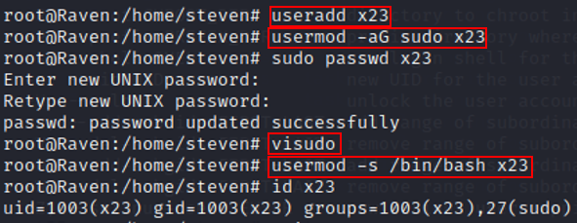
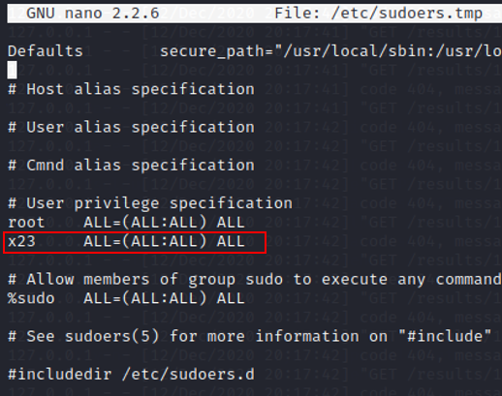
- obfuscated name – x23
- no home folder
- added to sudo group
- provided a login shell
- root level sudoers entry

Slide 14
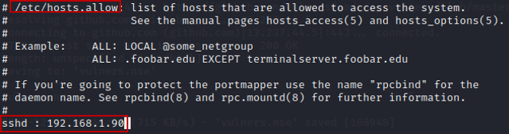
Whitelisting attacking machine IP:
add - sshd : 192.168.1.90 to /etc/hosts.allow

Slide 15
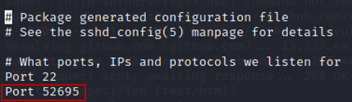
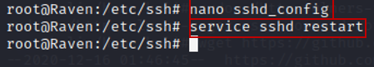
Open an obfuscated (high number), persistent
SSH port in the 50,000 range (port 22 may be monitored)
Add port in /etc/ssh/sshd_config
Restart the sshd service

Slide 16


Defensive hardening strategies
16

Slide 17
Defensive hardening strategies General Hardening and Principles Authentication Apache HTTP MySQL Wordpress SSH Monitoring
17

Slide 18
MITIGATIONS and HARDENING
General
1.1 Update OpenSSH to the latest version – 8.3.
1.2 Update Apache HTTP to the latest version – 2.4.46.
1.3 Update Samba to the latest version – 4.13.3.
1.4 Monitor SSH.
1.5 Monitor /etc/shadow and /etc/passwd folder.
1.6 Monitor failed logins.
1.7 Monitor excessive packets sent for brute force attacks
1.8 Monitor open ports.
1.9 Disable service scan details and obfuscate information provided in scan reports
1.10 Block all incoming SSH connections, while whitelisting known IPs.
1.11 Setup an IPS such as Fail2Ban, to blacklist SSH connections after a few failures.
1.12 Maintain a full backup in case of extreme compromise.
1.14 Remove unnecessary software and services.
1.15 Change default usernames and passwords; and reduce admin account privileges.
1.16 Principle of least privilege – restrict privilege wherever possible.
1.17 Regularly update and patch OS and applications.
1.18 Implement logging and auditing.
1.19 Review the companies Security Posture and employee education.
18

Slide 19
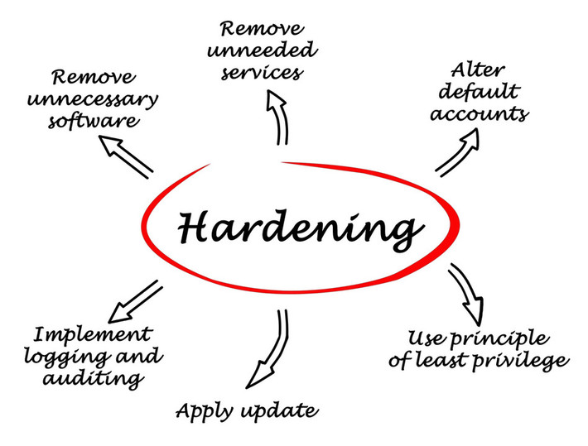
General hardening principles
19

Slide 20
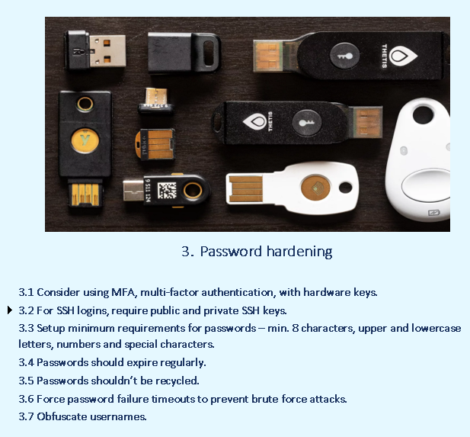
20

Slide 21
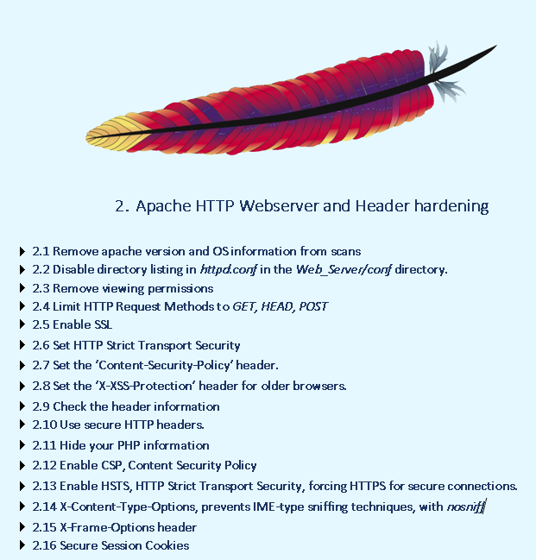
21

Slide 22
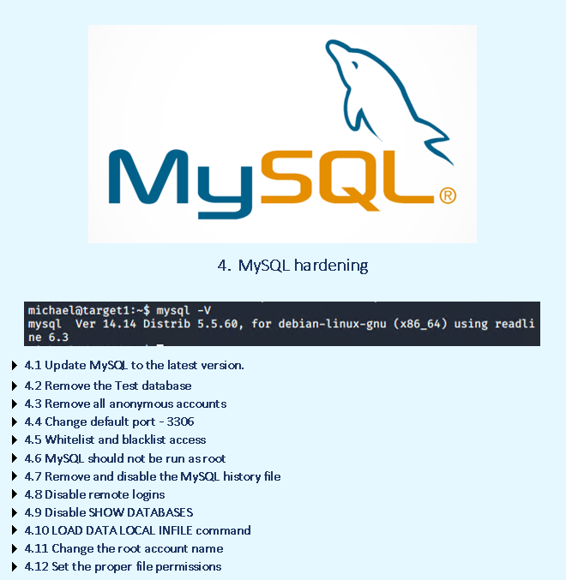
22

Slide 23
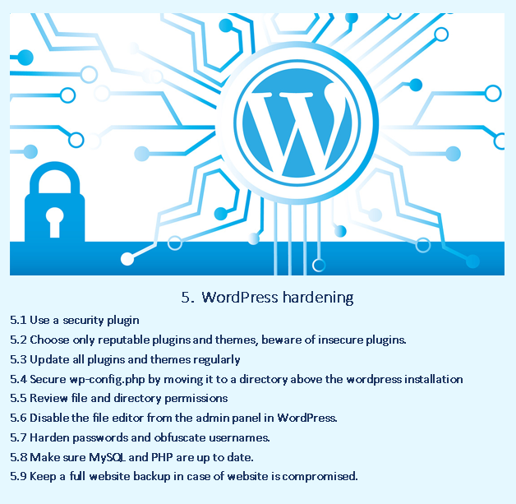
23

Slide 24
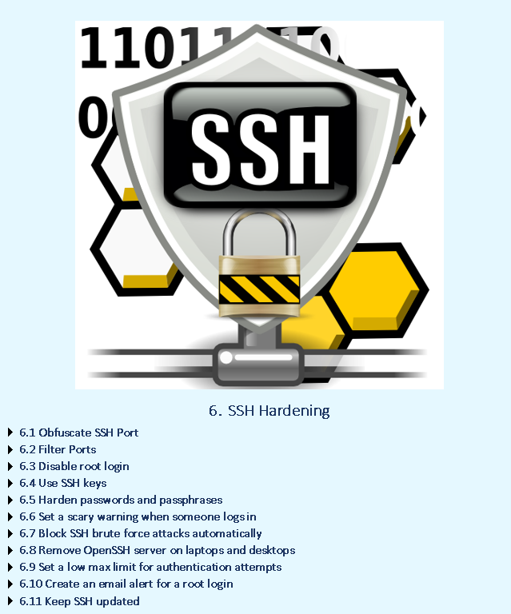
24

Slide 25

25

Slide 26
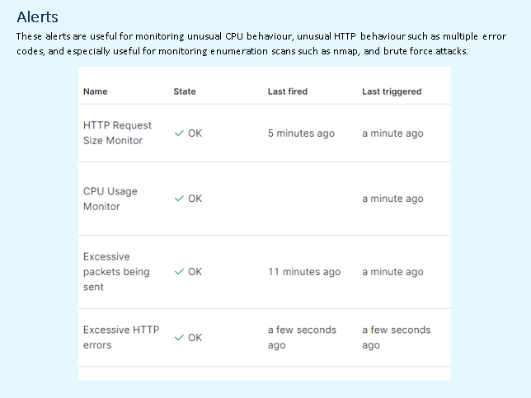
26

Slide 27
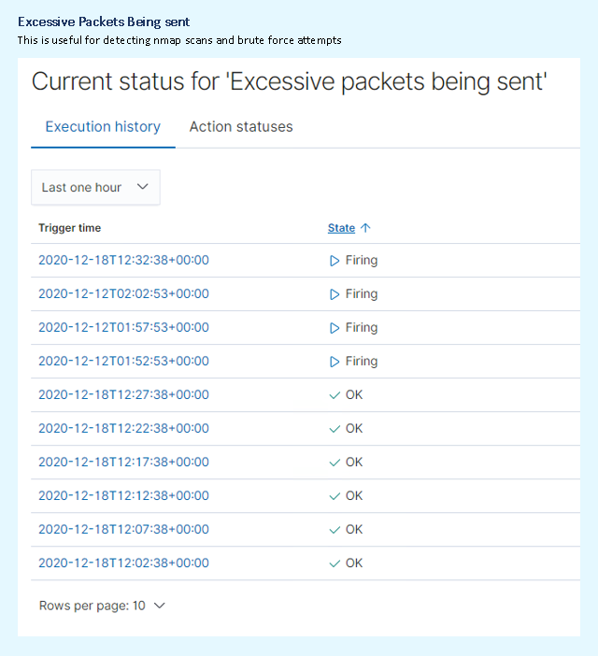
27

Slide 28
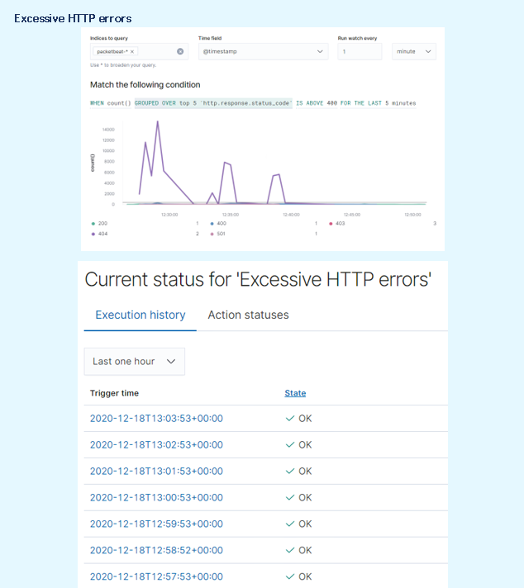
28

Slide 29
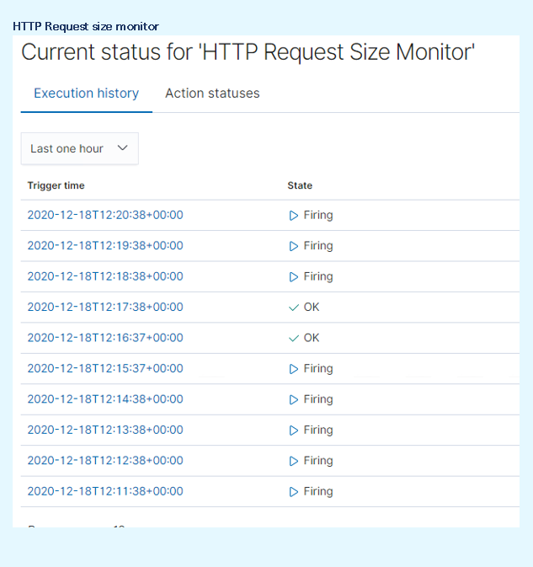
29

Slide 30
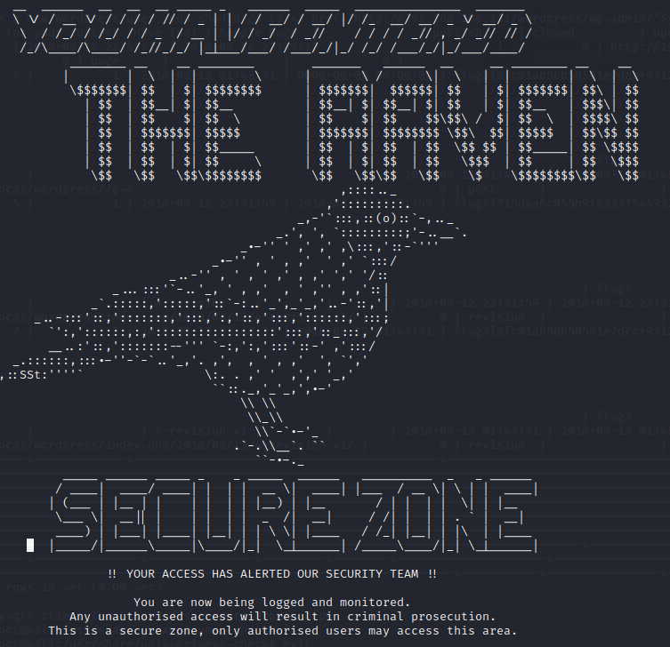
30

Slide 31
Thank You

Slide 32
Further in-depth report of Attack Narrative

Slide 33
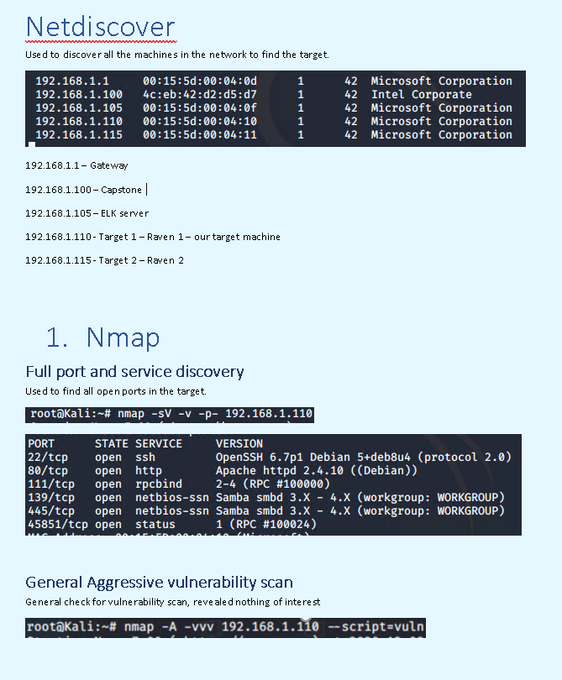

Slide 34
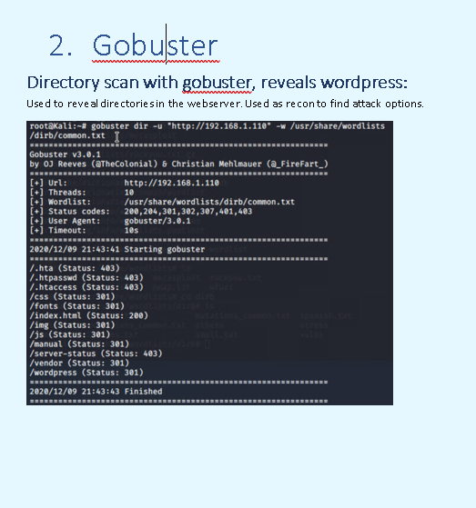

Slide 35
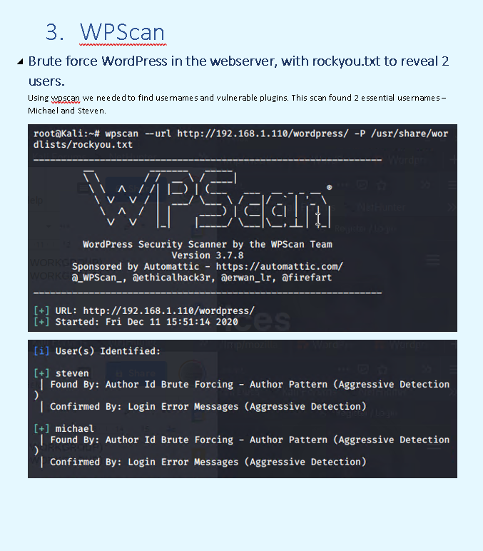

Slide 36
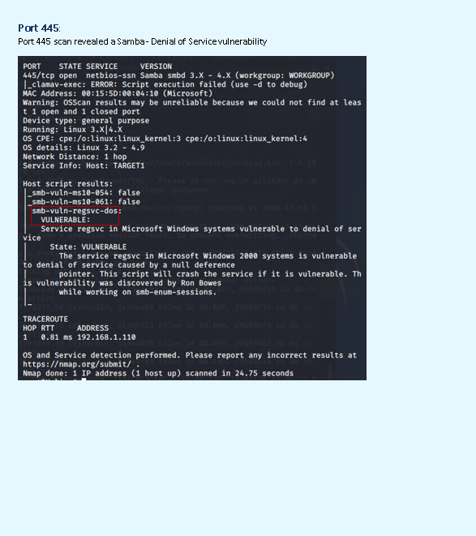

Slide 37
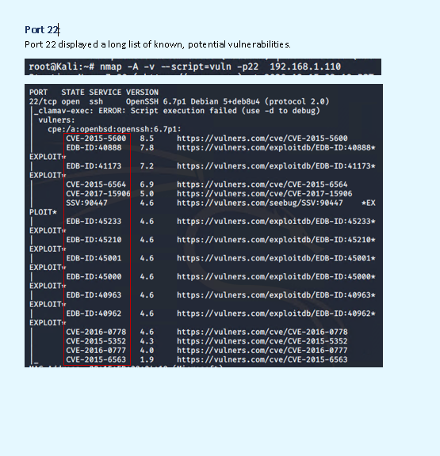

Slide 38
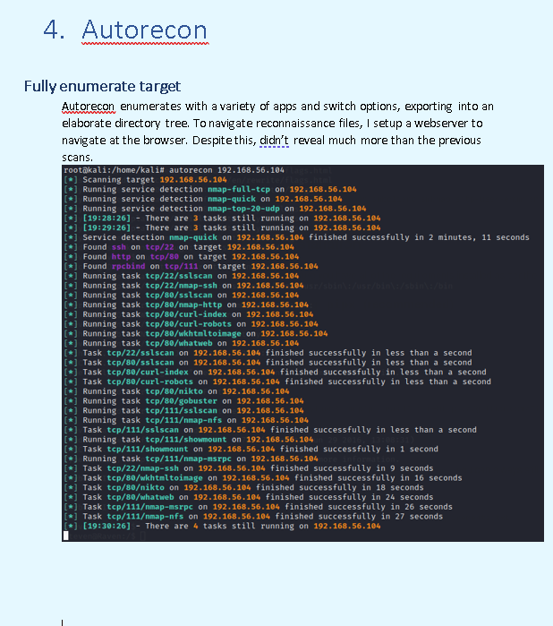

Slide 39
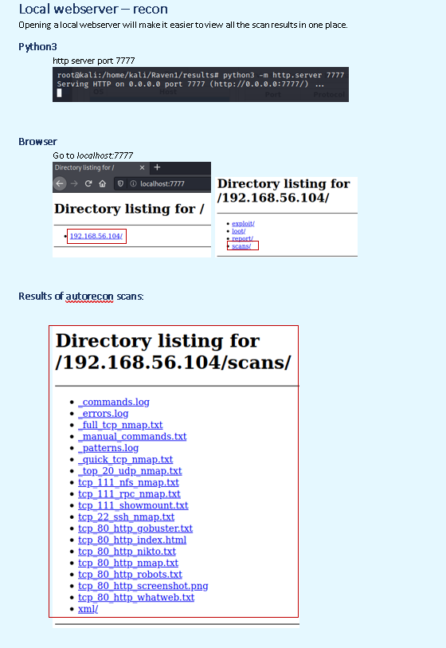

Slide 40
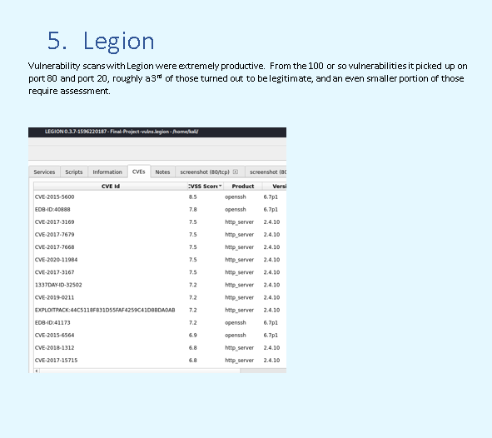

Slide 41
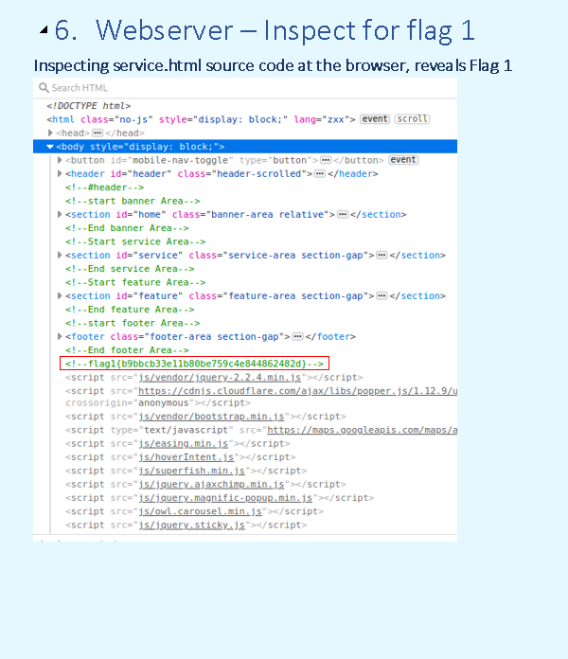

Slide 42
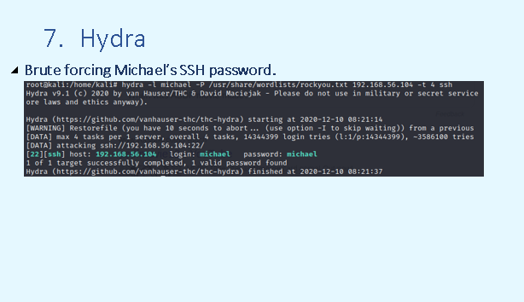

Slide 43
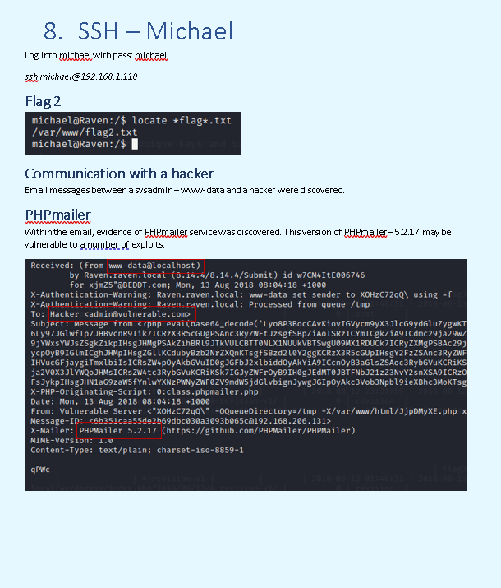

Slide 44
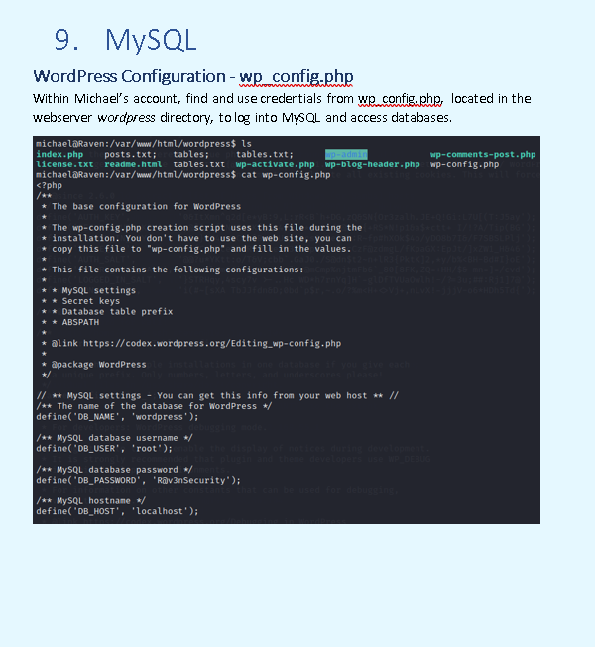

Slide 45
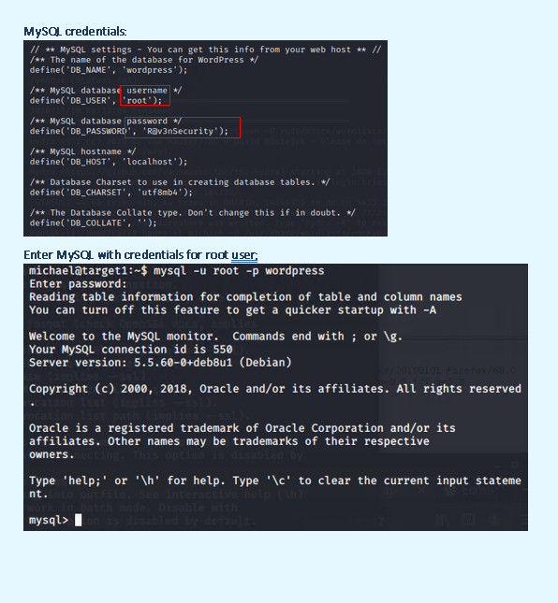

Slide 46
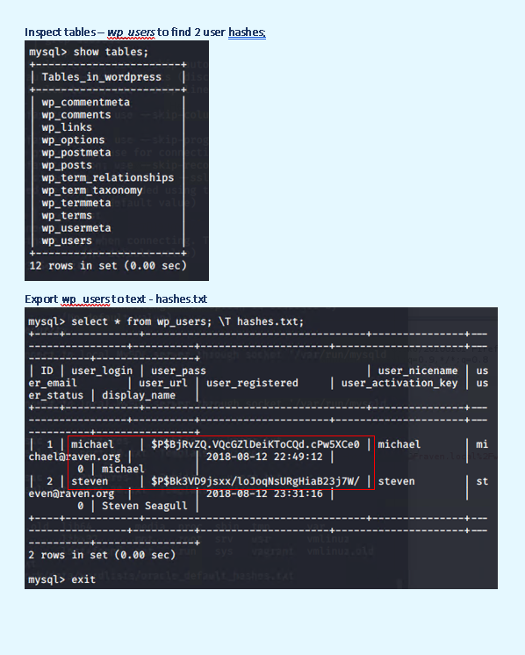

Slide 47
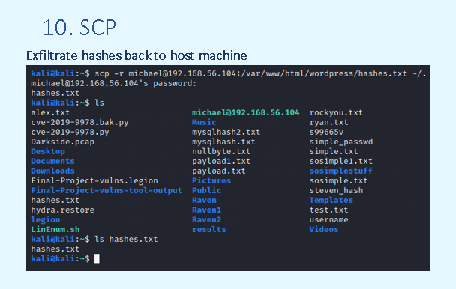

Slide 48
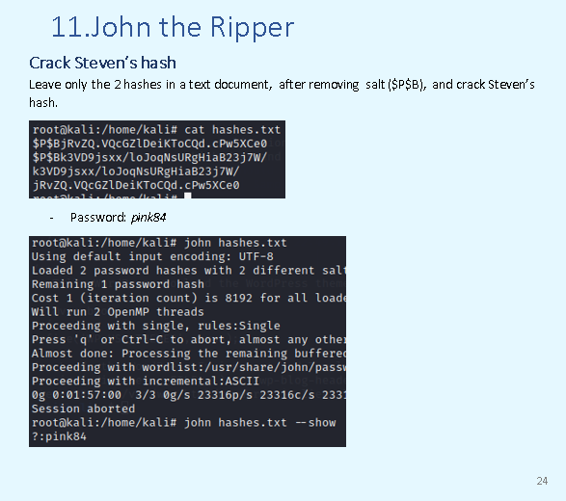

Slide 49
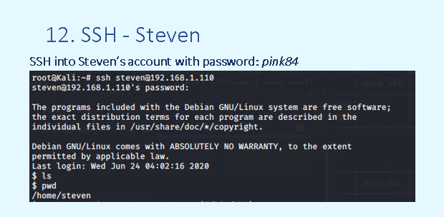

Slide 50
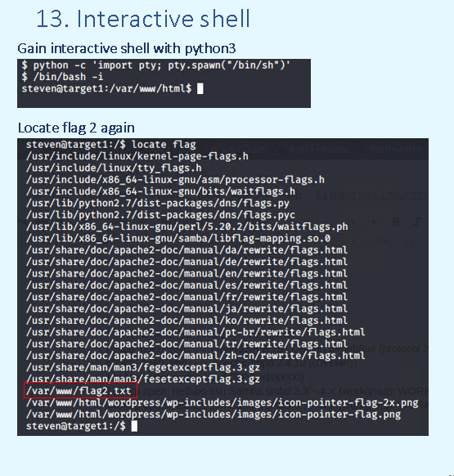

Slide 51
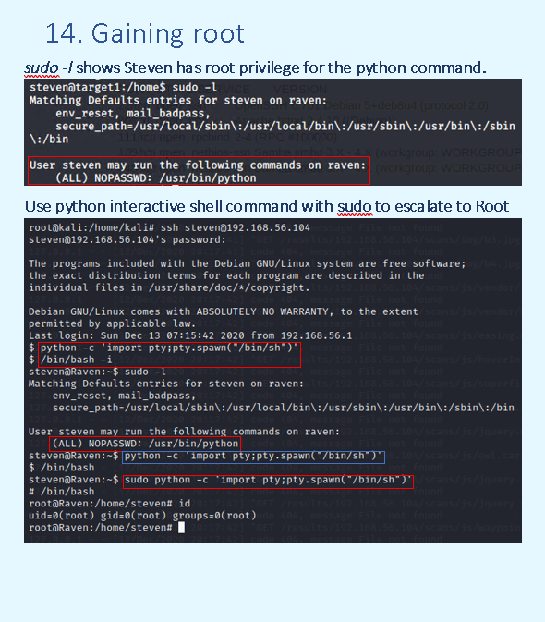

Slide 52
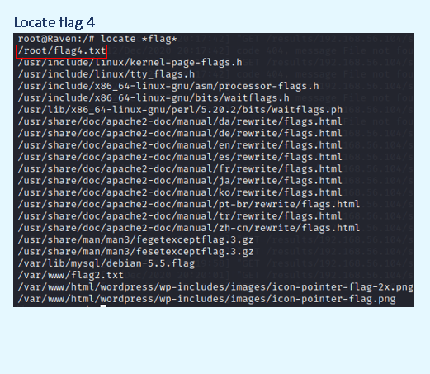

Slide 53
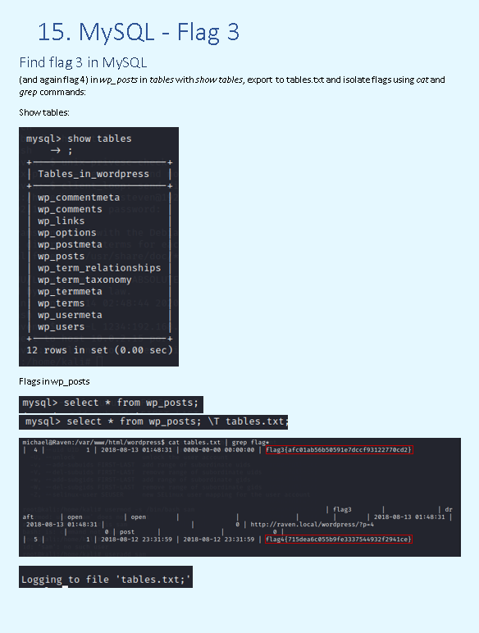

Slide 54
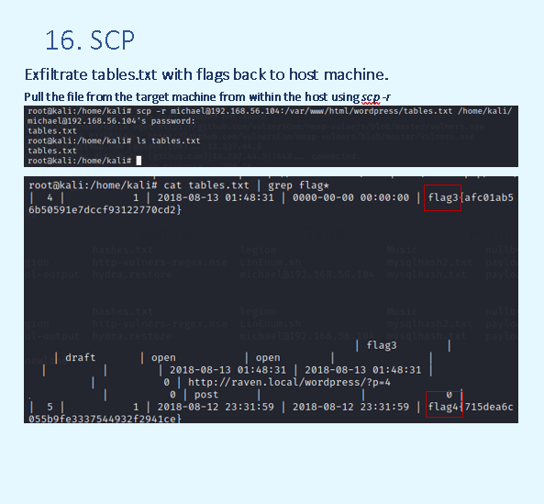

Slide 55
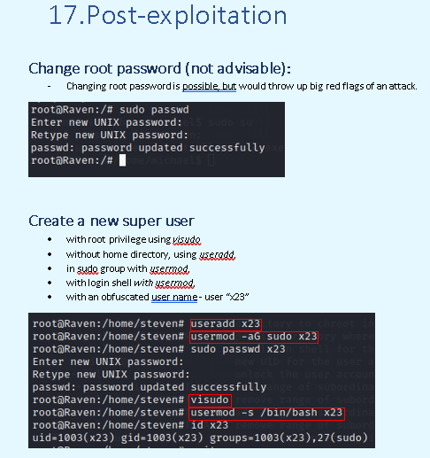

Slide 56
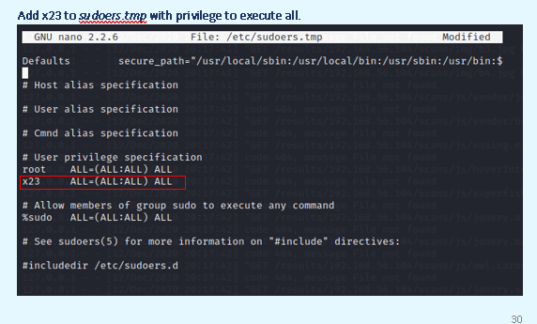

Slide 57
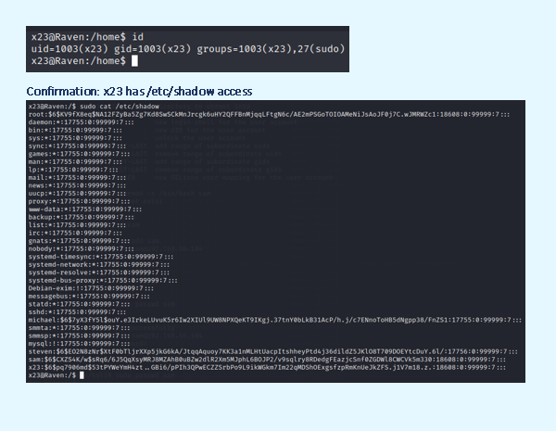

Slide 58
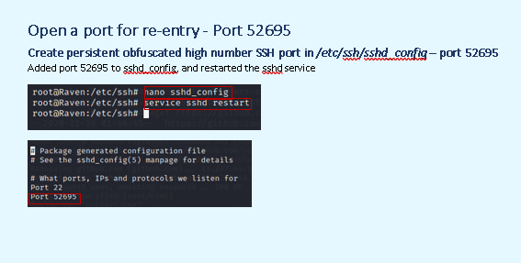

Slide 59
